Slide 1

C Developer
Foundation and First Steps

Slide 2

Course Objectives
Install tools
Compile your first program

Slide 3

Course Plan
1. C Language and Programs
2. Tools
3. Program Creation

Slide 4

1. C Language and Programs

Slide 5

1. C Language and Programs
History
SpeedCoding
1953
CPL
1963
BCPL
1966
C++
1983
Java & PHP
1995
FORTRAN
1957
ALGOL 60
1960
B
1969
C
1972
C#
2000

Slide 6
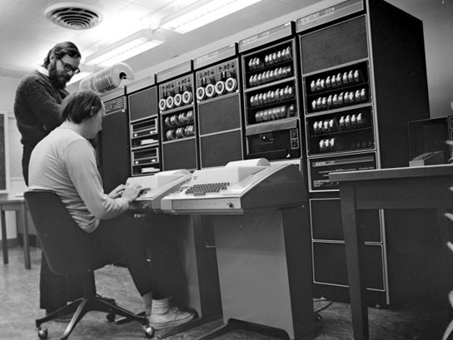
1. C Language and Programs
History
1969 – Ken Thompson, author of the B Language is joined by Dennis Ritchie
1972 – Dennis Ritchie added arrays, pointers, structures, etc.
1973 – UNIX is rewrited in C

Slide 7
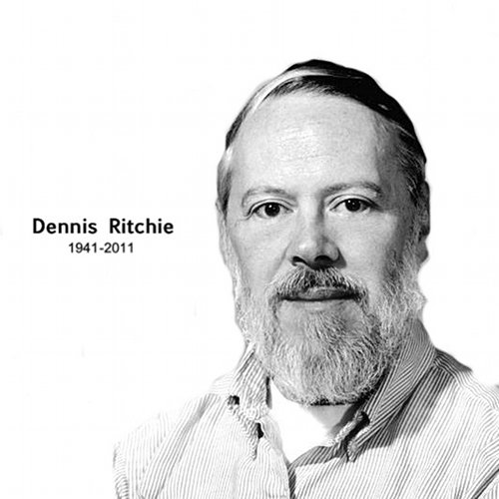
1. C Language and Programs
History
Dennis Ritchie (1941-2011)
1970 – Developer for Bell Labs (AT&T)
1972 – C language creation
1983 – Turing Award

Slide 8
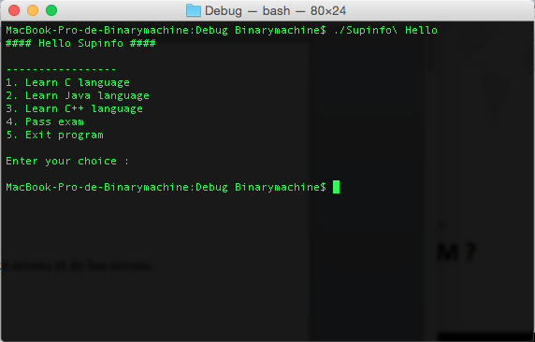
1. C Language and Programs
Features
Console application
Daemon
Utility
Driver

Slide 9
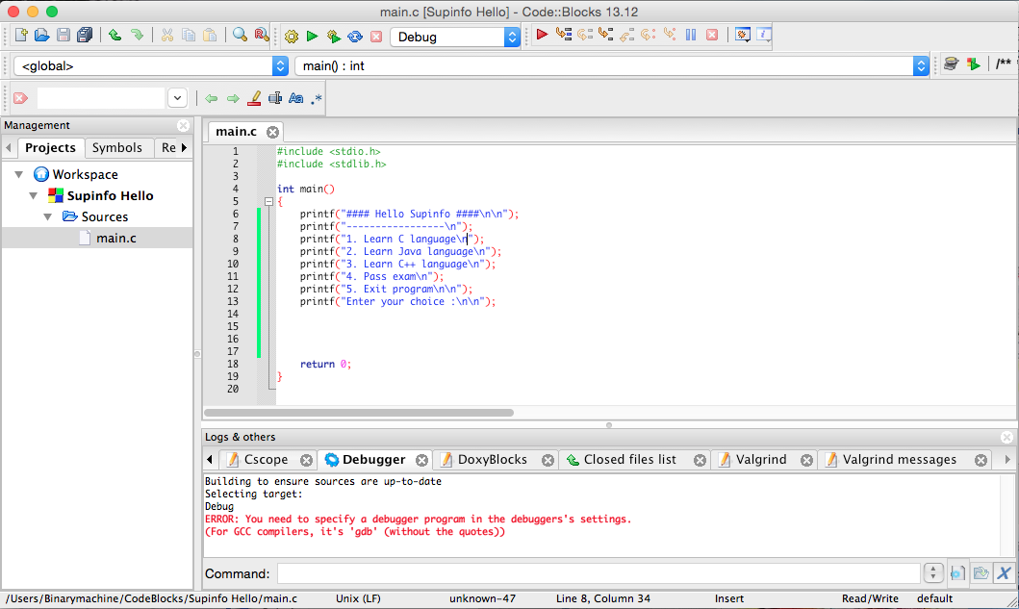
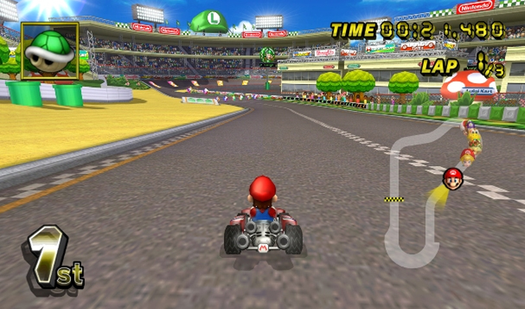
1. C Language and Programs
Features
Graphic application
Games

Slide 10
1. C Language and Programs
Low-level and High-level Languages
High-level
– The system management is abstract
Low-level
– Memory management can be done by the developer
– Can manage system resources to optimize

Slide 11

1. C Language and Programs
Low-level and High-level Languages
The C language is used in:
– Operating System
– Embedded System
– Robotics
– Games
– Utility
– Parallel programming
– etc.

Slide 12
1. C Language and Programs
Programs
A program is a computer tool that meets a need
Solution to a need for:
– Data processing
– Tasks performing
– Human/machine interaction
Each application is:
– Compiled or Interpreted language
– Written in understandable language
– A sequence of instructions

Slide 13

1. C Language and Programs
Questions

Slide 14

2. Tools

Slide 15

2. Tools
Environment
A text editor
– To write source code
A compiler
– To compile and edit links

Slide 16
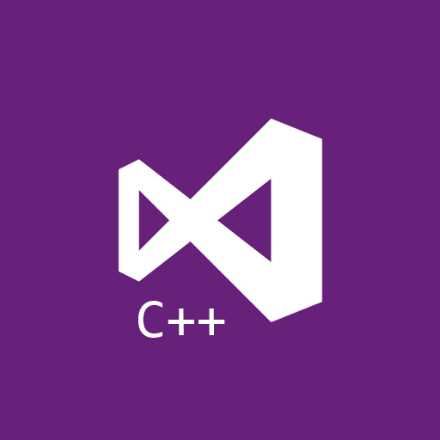
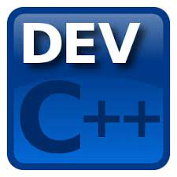
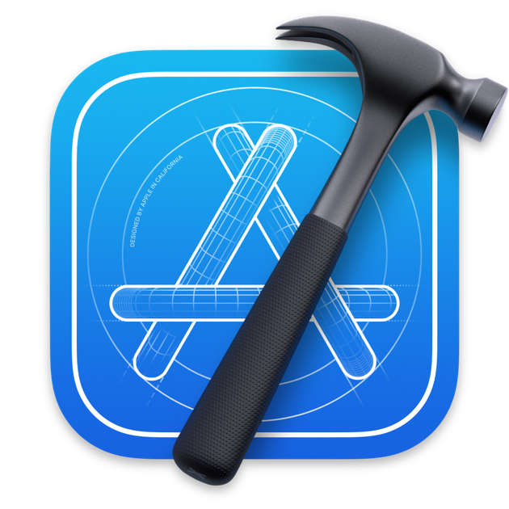
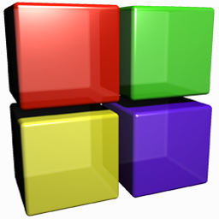
2. Tools
Environment
IDE examples:
Visual C++, Dev C++ for Windows
Xcode for Mac
Code::Blocks for Windows, Mac and Linux
We will use Code::Blocks for this course!

Slide 17
2. Tools
Code::Blocks
Free
Open-Source
Cross-platform
Designed for C, C++ and Fortran
Extensible by plugins
https://www.codeblocks.org/downloads/binaries/

Slide 18
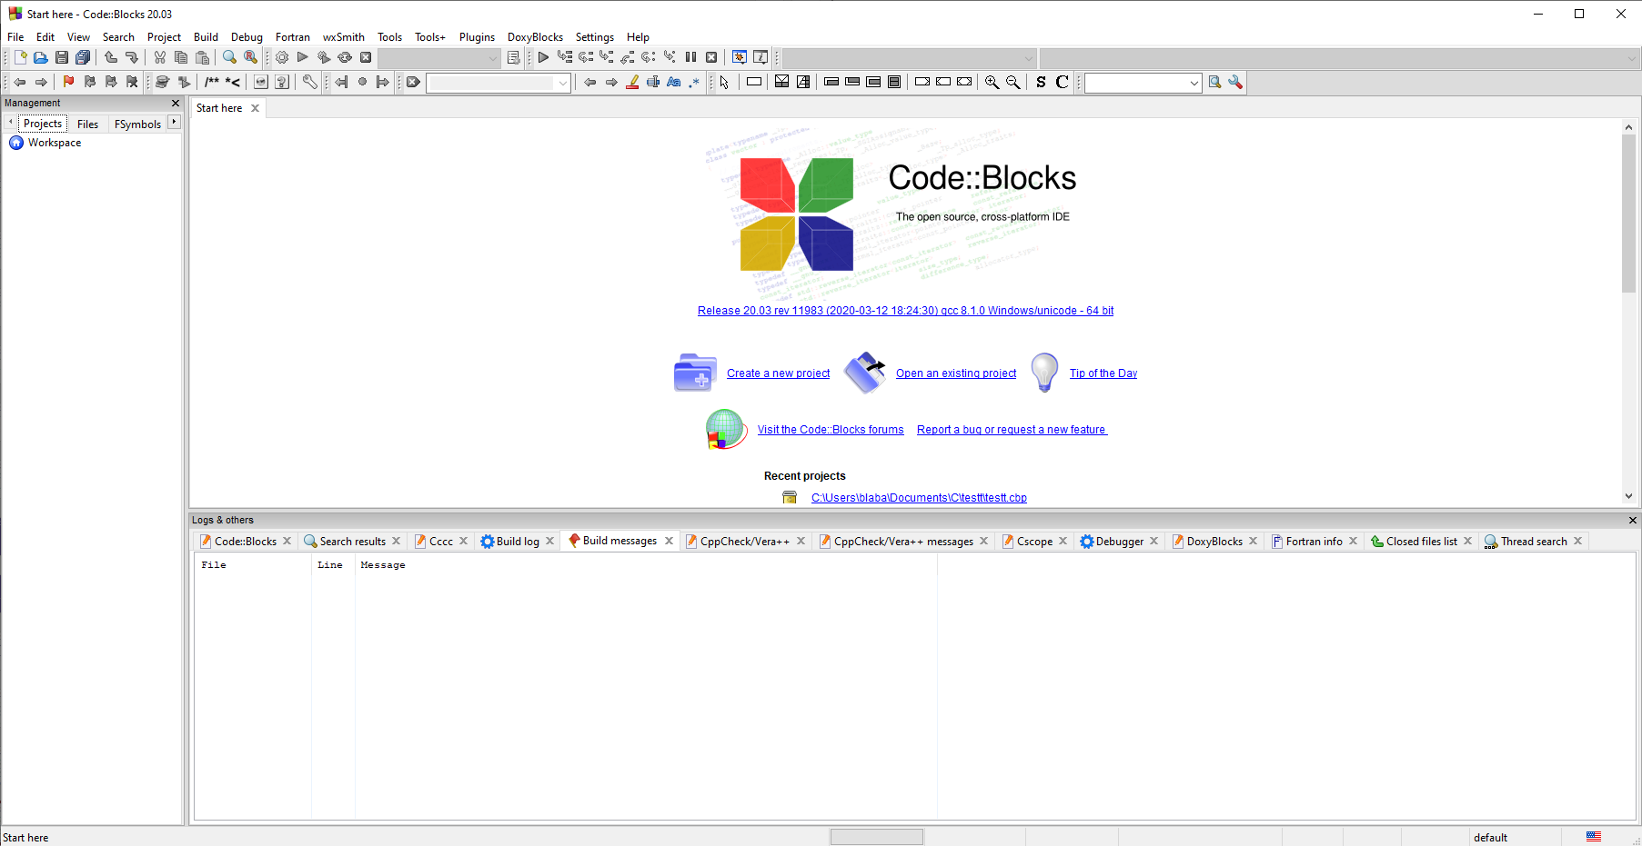
2. Tools
Code::Blocks
Editor
Projects
Console

Slide 19
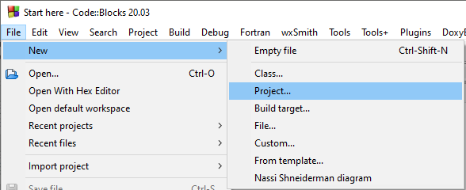

2. Tools
Code::Blocks
OR

Slide 20
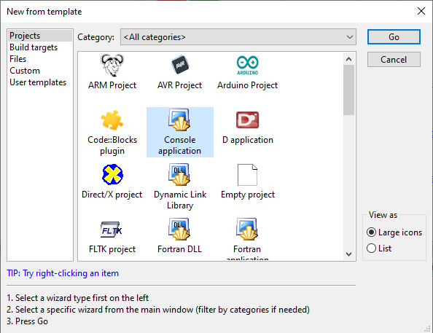
2. Tools
Code::Blocks

Slide 21
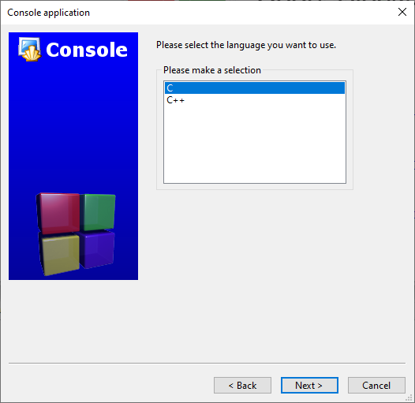
2. Tools
Code::Blocks

Slide 22
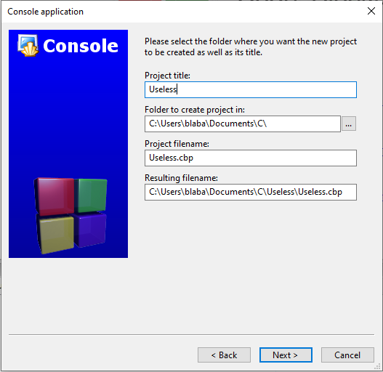
2. Tools
Code::Blocks
Enter a name for your project and the project location

Slide 23
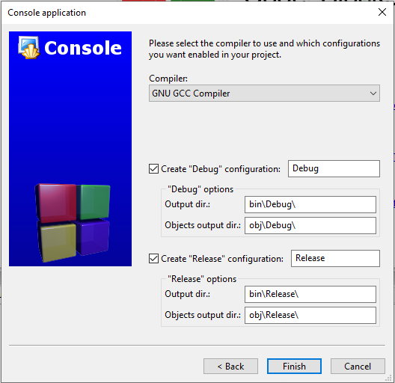
2. Tools
Code::Blocks
Keep the default compilation settings

Slide 24
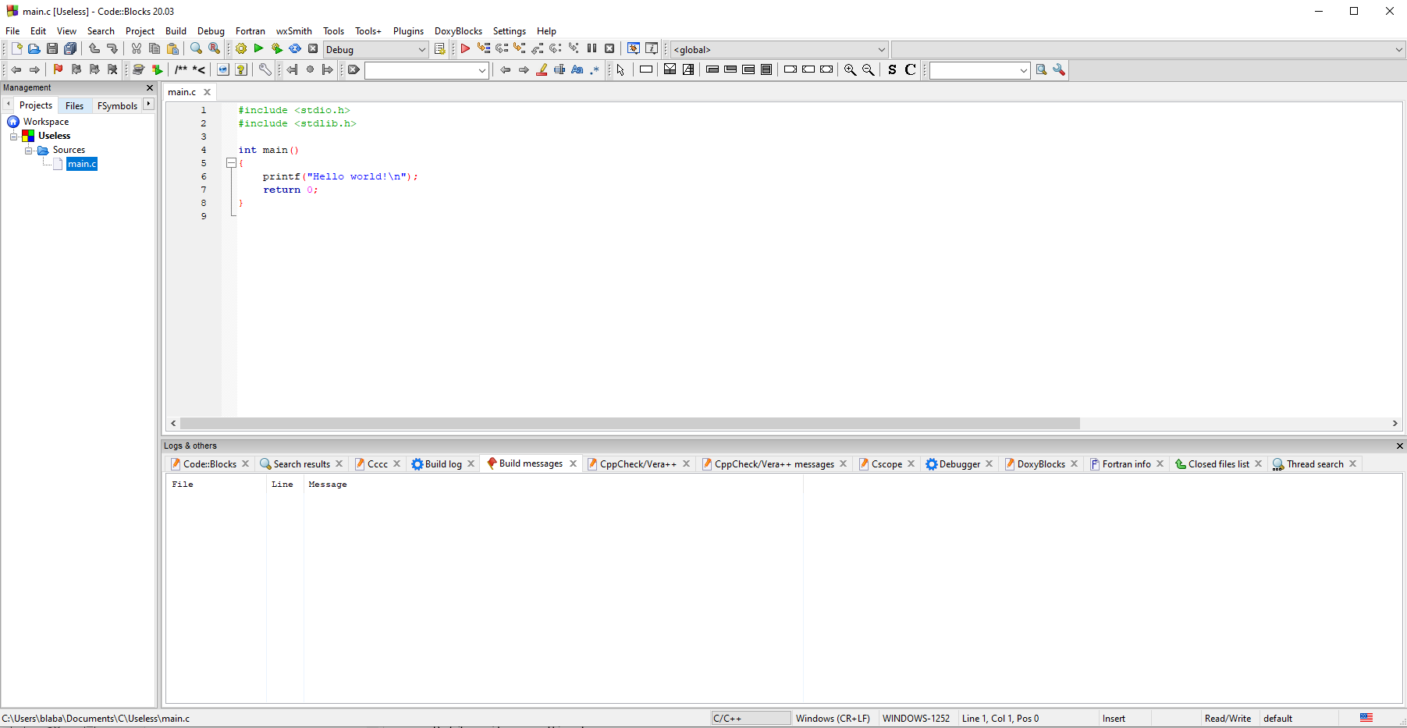
2. Tools
Code::Blocks

Slide 25
2. Tools
Code::Blocks
To test a project, click on Build then on Run or directly on Build and run
Build
Run
Build and run

Slide 26
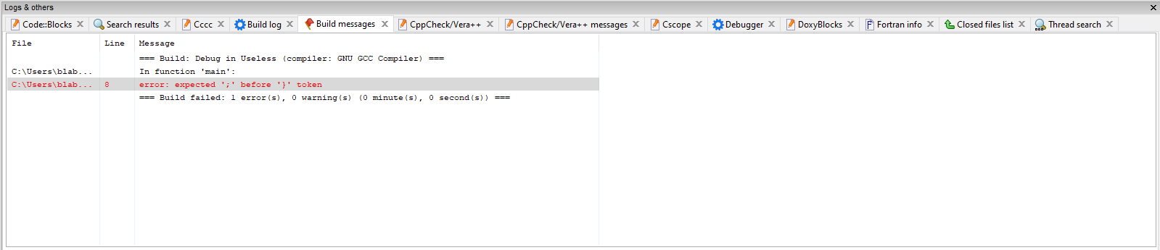
2. Tools
Code::Blocks
The debugger is a very useful part of the IDE. Find your errors with it.

Slide 27
2. Tools
Questions

Slide 28

3. Program Creation

Slide 29
3. Program Creation
Overview
Three steps:
Write source code to include the features
Compilation to convert to binary "machine code"
Link Editing to group all binary files into an executable file

Slide 30
3. Program Creation
Step 1: Write source code
Source code is a set of text files
Represent a set of instructions of a program
May contain libraries
– .so or .a files for UNIX
– .lib files for Windows

Slide 31


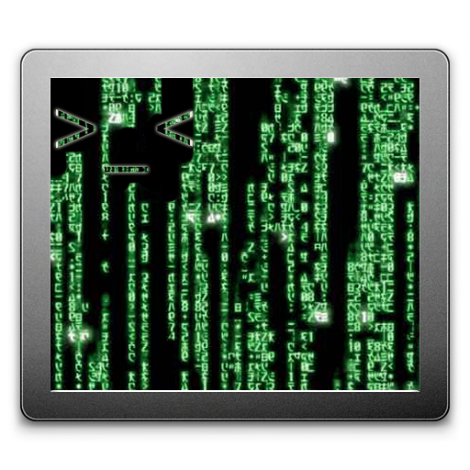
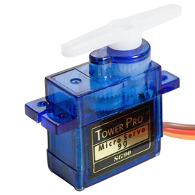
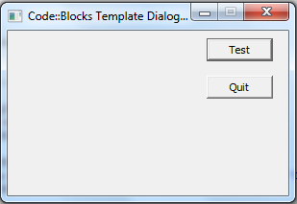
3. Program Creation
Step 1: Write source code
The C language has a lot of libraries available for:
– Creating games
– Creating GUI applications
– Manipulating environment
– Using specific components
– Saving progamming time
– Creating games

Slide 32
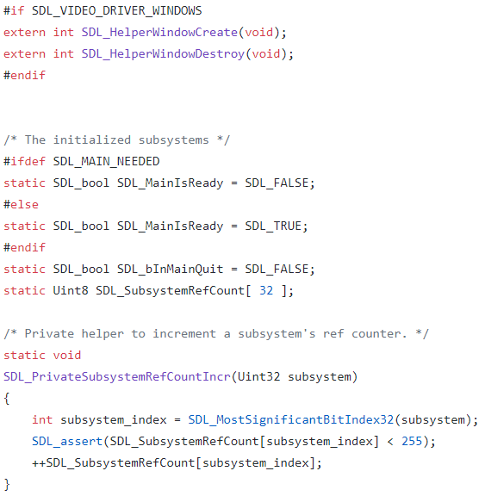
3. Program Creation
Step 1: Write source code
All C programs are composed of .c files…

Slide 33
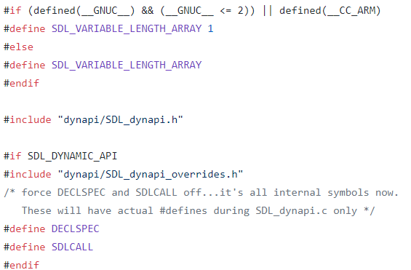
3. Program Creation
Step 1: Write source code
… and .h files

Slide 34

3. Program Creation
Step 2: Compilation
.h
.h
.c
Preprocessor
.c

Slide 35
3. Program Creation
Step 2: Compilation
.c
.c
.c
Compiler
.o
.o
.o

Slide 36
3. Program Creation
Step 3: Link Editing
.o
.o
.o
Linker
.exe

Slide 37


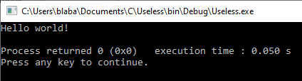
3. Program Creation
Execute/Run
Linux or Mac
Windows
Using the IDE Run button that opens the console

Slide 38
3. Program Creation
Questions

Slide 39

C Developer
Foundation and First Steps
Thank you for your attention

